Slide 1

TPP Online Filing Instructions

Slide 2
TPP DR-405 ONLINE FILING
Each year, in January, a web access code letter will be mailed to the business owner with a unique 14-digit CONFIDENTIAL WEB-ACCESS Code. If you filed on-line in a prior year, your CONFIDENTIAL WEB-ACCESS Code remains the same.
The CONFIDENTIAL WEB-ACCESS Code can only be provided to owner through US mail sent to the mailing address on file.
Business owners/Tax preparers must enter this code to access and update their business assets and contact information.
The On-Line website is also available to export your prior year’s asset list to an Excel spreadsheet, which can be edited and imported back to us in our format On-Line.

Slide 3
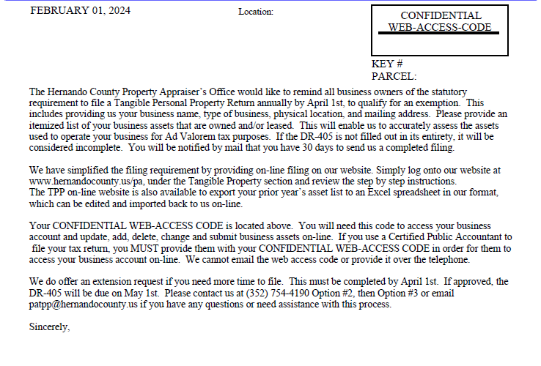
SAMPLE WEB-ACCESS CODE LETTER

Slide 4
HOW DO I FILE ONLINE?
Visit our website at https://hernandopa-fl.us/
Under the information section, select Tangible Property Online, and select “File TPP Return Online….” which is highlighted in Orange.
Read the step-by-step On-Line filing instructions (this slide) to understand the requirements and process, including when to enter the following codes:
    Your Password (created by you) for logging into your Online Account;
    Your Account Validation Code (emailed to you) used to create your Online Account;
    Your Confidential Web Access Code (mailed to you in January) used to gain access to your business information and DR-405 submission.

Slide 5
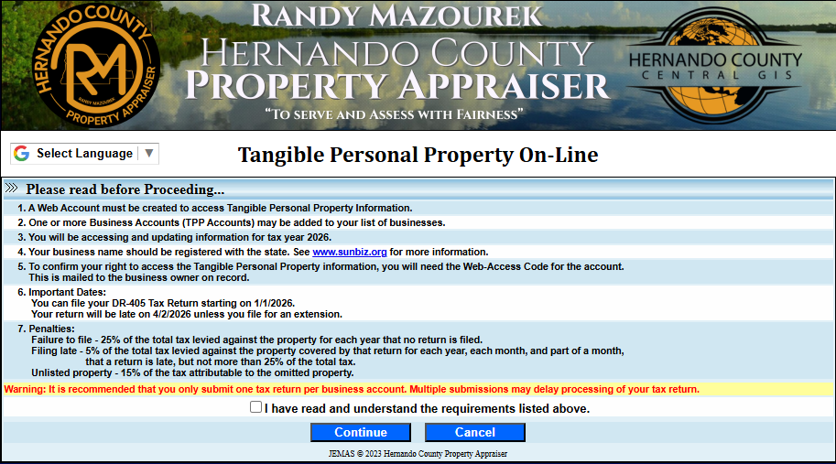

HOW DO I FILE ONLINE? (Continued)
Once you have reviewed the online filing instructions, select “TPP On-Line”
Select the box confirming that you have read and understand the requirements and select “Continue”

Slide 6
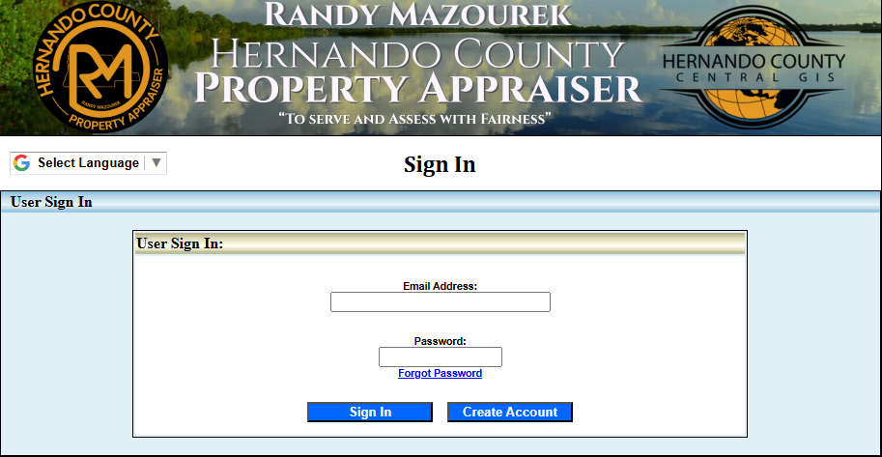
If you filed On-Line last year, you have an existing web account, select sign in, then:
First time filing on-line, you must create a web account.
Enter your Email address
Enter your Password
Select
Select
Instructions for New Accounts CLICK HERE
Instructions for Returning Users CLICK HERE
Note: If the email address entered is different than last year’s, you must first create a web account.

Slide 7
How to: Create a New User Account
(If you don’t need these instructions click here to skip to asset editing instructions)

Slide 8
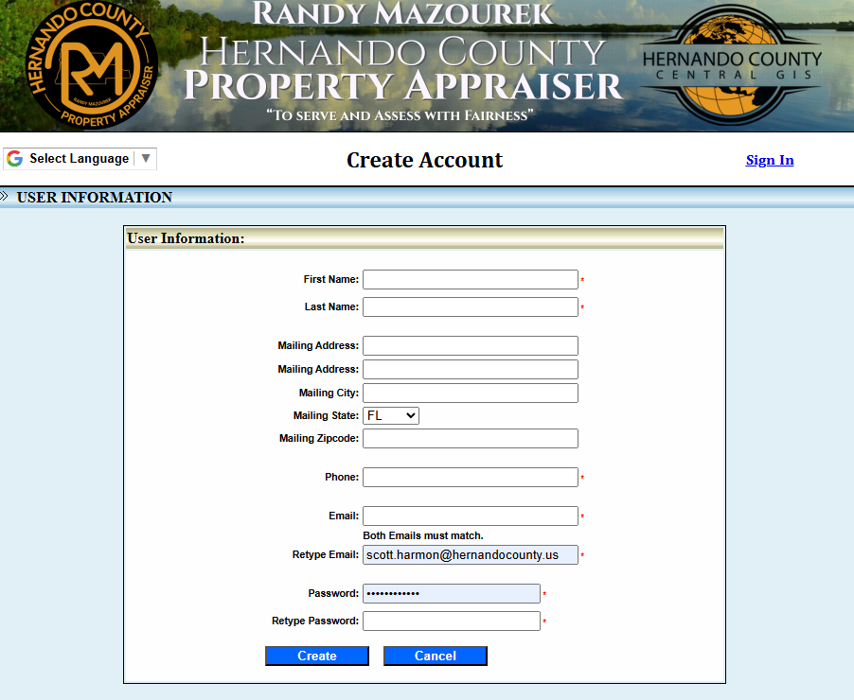
Complete all fields and select “Create”

Slide 9
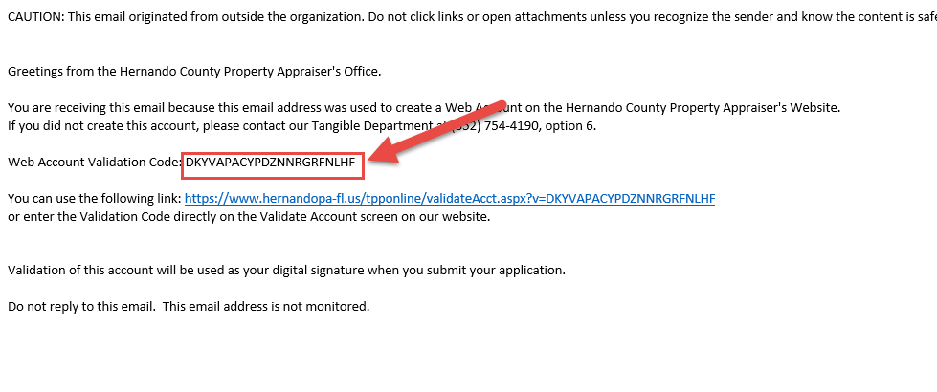
You will receive an email containing your Web Account Validation Code. Validation of this account will be used as your digital signature.

Slide 10
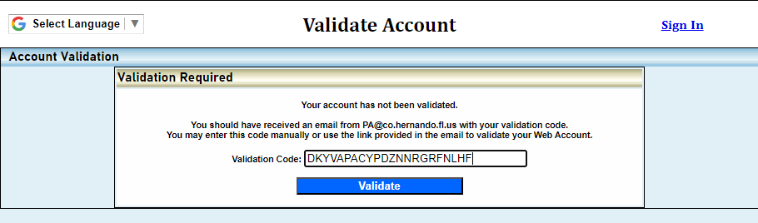
Select the link provided in the email or copy and paste your Validation Code from the email into the Validation Code field and select “Validate”.
Do not enter your unique CONFIDENTIAL WEB-ACCESS CODE provided in the letter. It will not work! Only enter the code in the Validation email.

Slide 11
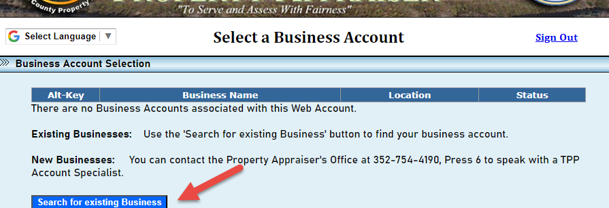
Select “Search for Existing Business”

Slide 12
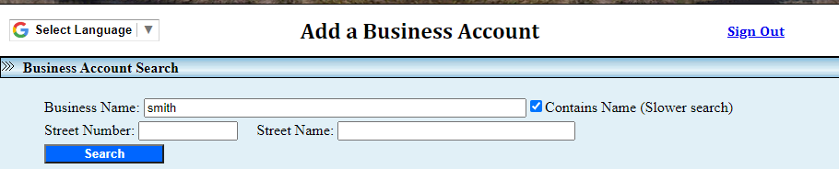
To search for a business, search by the full name or a portion of the business name. To search using a portion of the business name, check the select “contains name” box. Select “search” once you have entered the information.
Note: Leased accounts will only show the primary account. You must edit each of the assets with the correct address/location. Our system will automatically distribute to the correct secondary accounts.

Slide 13
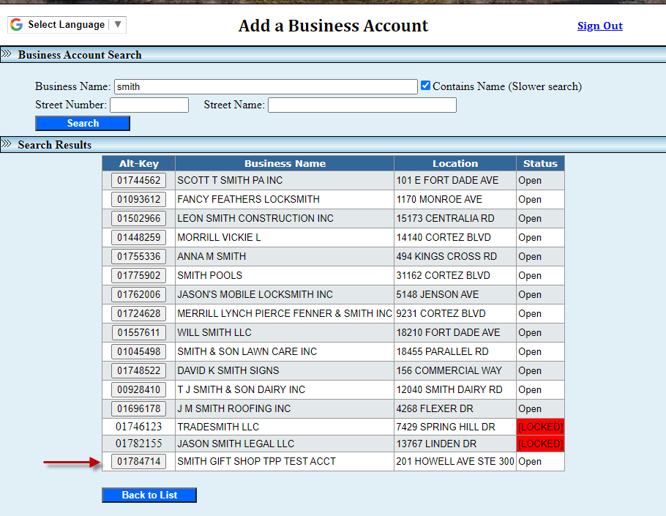
Next, find your business and select the corresponding box under the Alt-Key column.

Slide 14
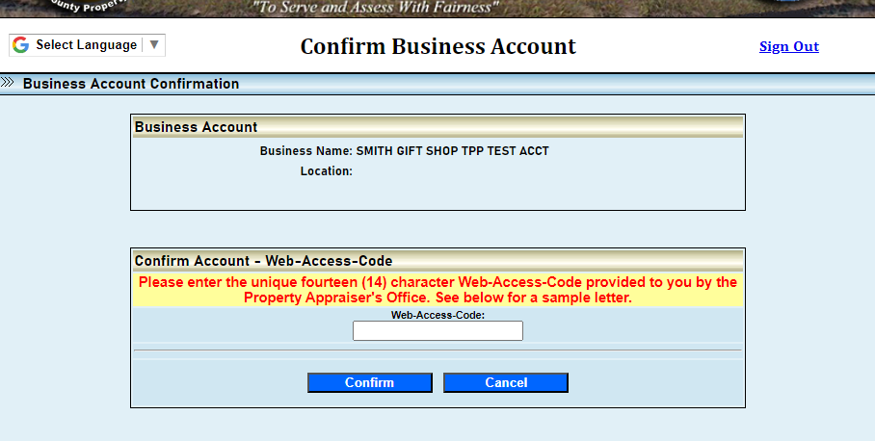
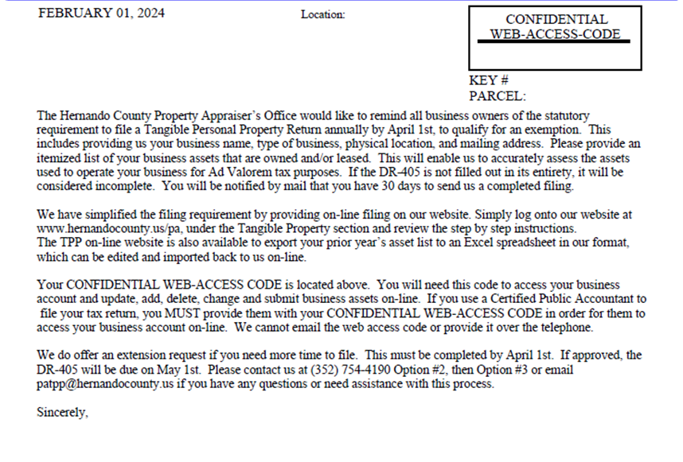
This next screen is where you will put your unique Web-Access-Code (14 digits long). See letter below where to find yours. Click Confirm when done entering.
goes here
This code

Slide 15
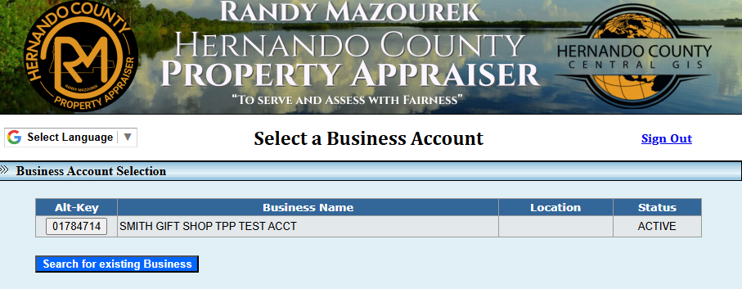
Select the Alt-Key button for the business listed to view the business account and asset summary

Slide 16
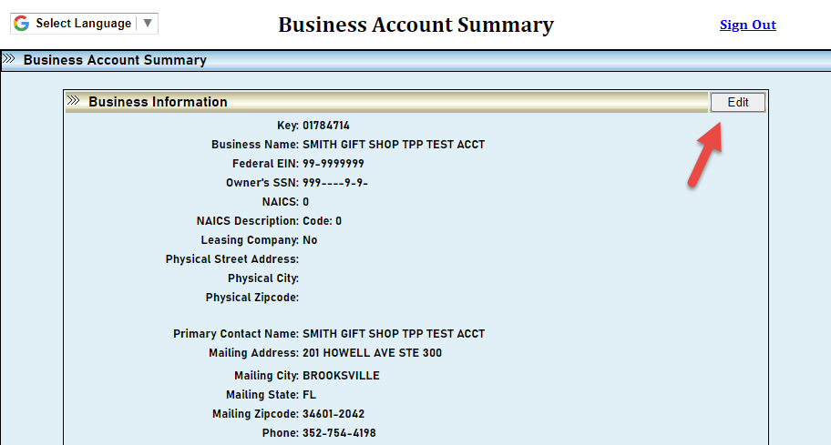
To update the business information, contact information, or close the business, select “Edit” at the top right corner of the Business Account Summary box. (If no changes continue to slide 17)

Slide 17
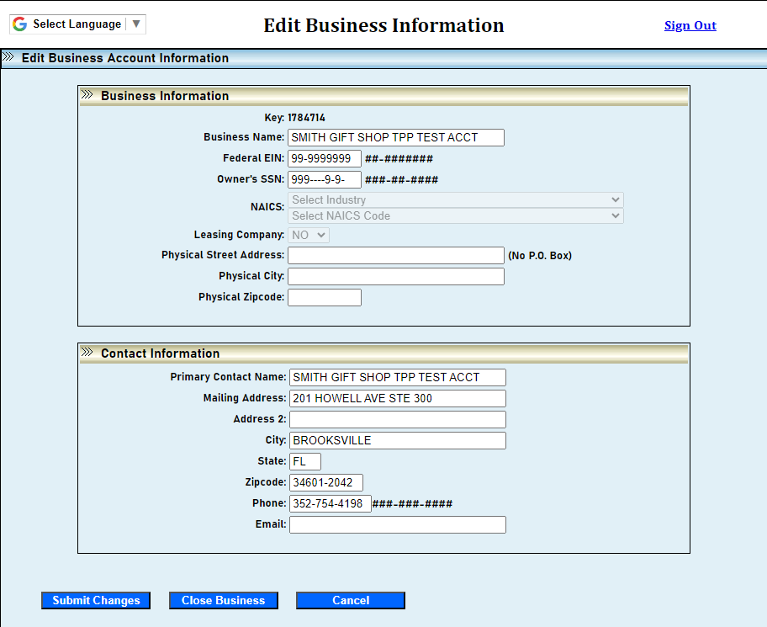
Be sure to enter the correct physical location of the business in the Business Information section.
Enter the contact information and correct mailing address in the Contact Information section.
Select “Submit Changes” once your changes are complete
If you are closing the account, select “Close Business”

Slide 18
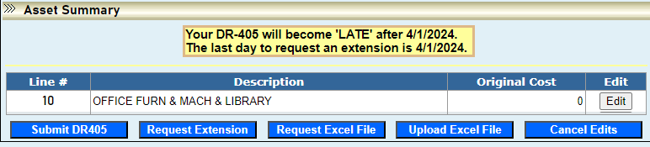
ASSET SUMMARY OR EXCEL UPLOAD:
After making sure your account information is completed and up to date, you are ready to begin filing your assets
You have two options to file your assets online:
  Use the asset summary section to manually add, update, or remove each asset (next slides) or;
  Upload an excel file and the SIGNED first page of the DR-405 (go to slide 29)

Slide 19
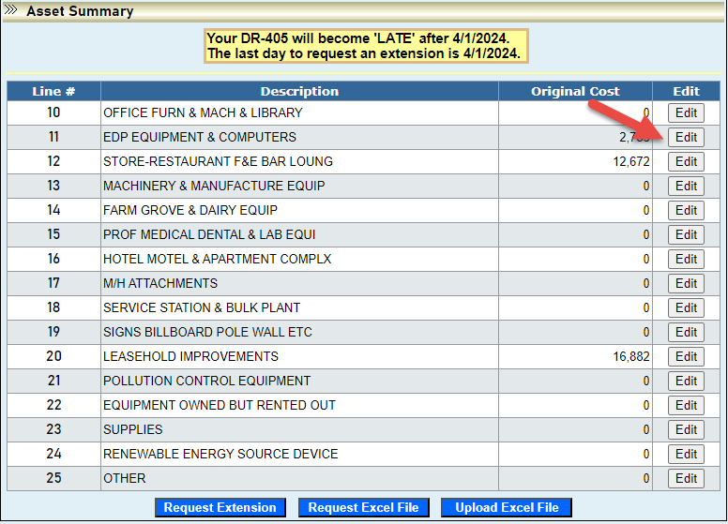
Asset Summary: Editing Assets
Select the edit button to view and update all the business assets in each Summary Line.
  Note: If the asset is leased or rented, you must use Summary Code 22

Slide 20
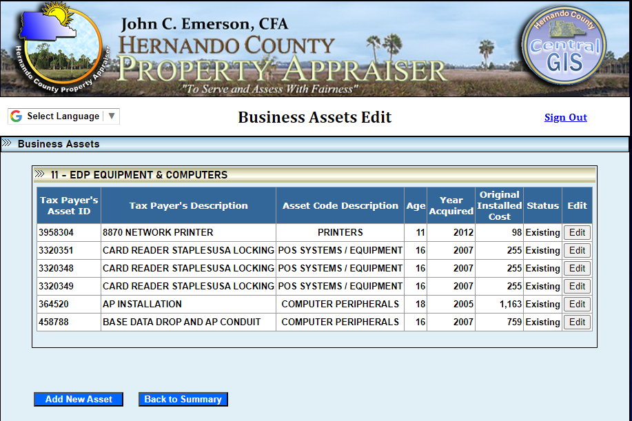
Select the business asset by selecting the Edit button next to each asset or select the Add New Asset button at the bottom to add a new asset.
Edit existing asset
or Add new
Note: View the next slide for guidance on entering the effective year and year acquired.

Slide 21
Year Acquired vs. Effective Year
The Year Acquired is the year that you purchased the asset for your business
The Effective Year is the year that the asset was made, constructed, or manufactured. This determines the age of the asset.
  We do not count the current year when calculating the age of the asset

Slide 22
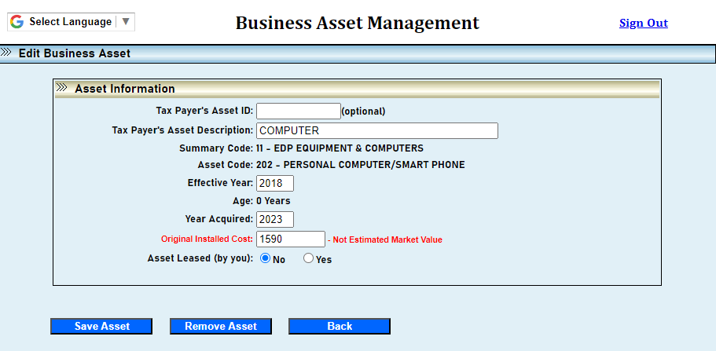
After editing each asset, select “Save Asset”. If an asset was removed, select “Remove Asset.”
If an asset is leased, click on yes.

Slide 23
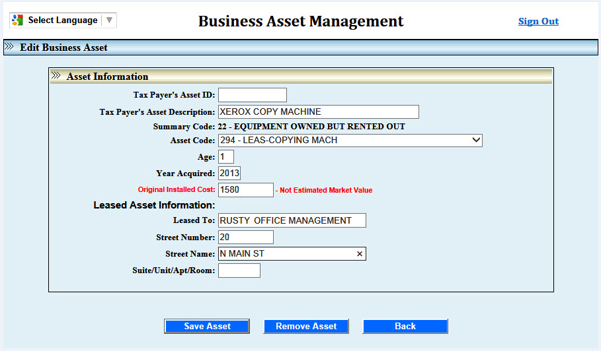
Leased assets must be entered in Summary Code 22 – Equipment Owned but Rented Out. You must enter a Hernando County address for every leased asset. The address entered will determine the correct Taxing District and Levy Code.

Slide 24
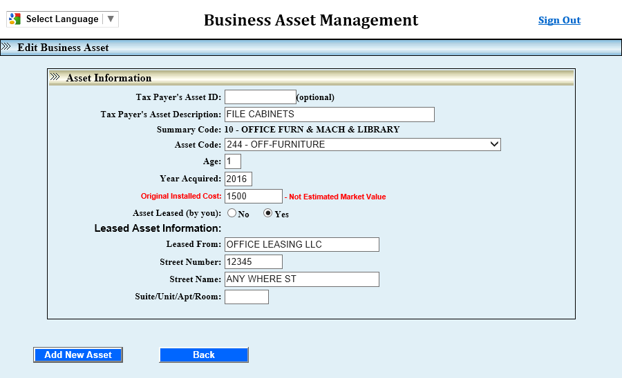
If you are leasing an asset from another company, enter the lease company’s name and address at the bottom of the asset detail.

Slide 25
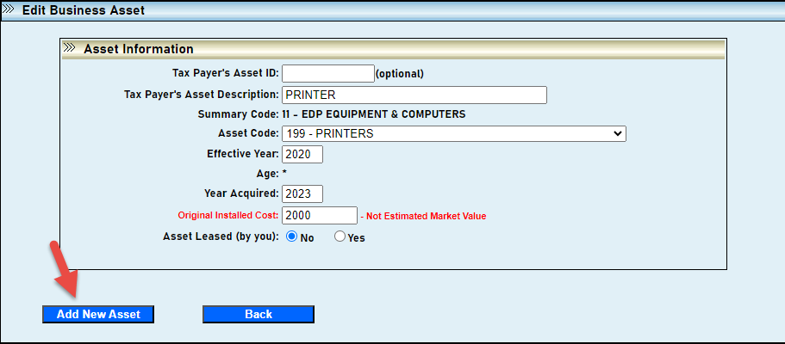
If not leased, to add a new asset simply click on Add New Asset. (The asset code defaults to the first in the drop-down list.)
Click ‘Back to Summary’ to return to Asset Summary List.

Slide 26
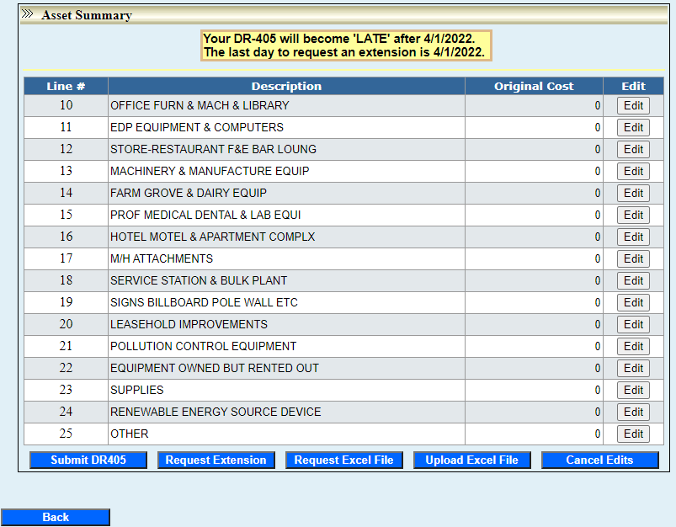
When the DR-405 is ready to be filed, review the
Asset Summary before selecting “Submit DR405.”
Your DR-405 will become “LATE” after 4/1/2024.
The last day to request an extension is 4/1/2024.
Note: If the submit button does not appear click on
“Edit” for any asset and then “Back to Summary” (Even if you aren’t editing, it will only appear if you click on something.)

Slide 27
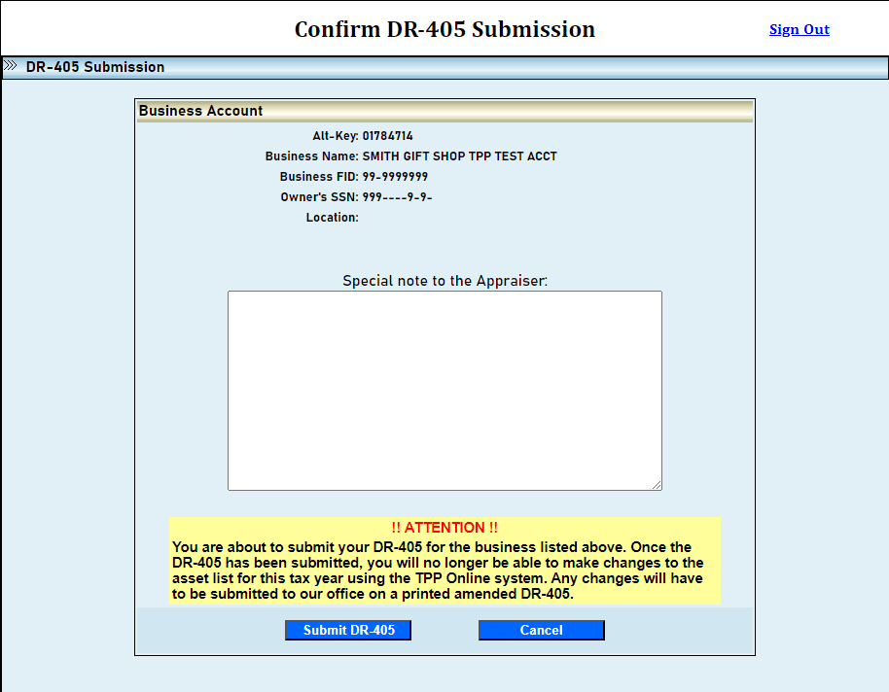
Add special notes to advise us of any changes. Once you have reviewed your DR-405 asset detail and there are no additional changes, you are ready to file the return with our office.
Once you have submitted your DR-405, you will not be able to make changes to your online filing for this year!

Slide 28
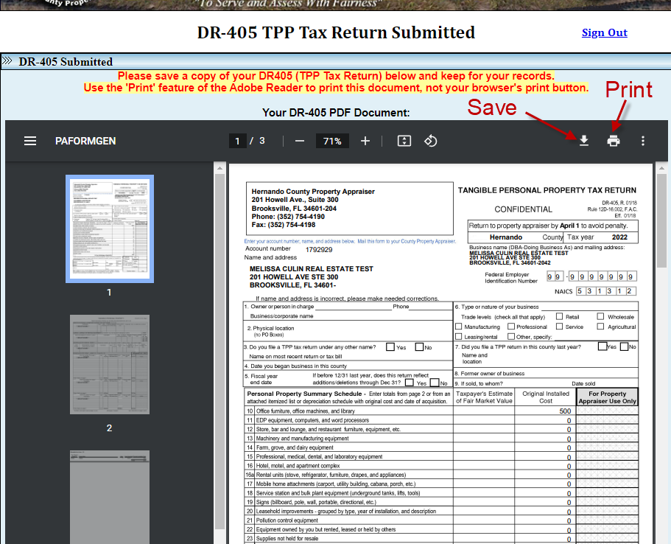
To view the DR-405 PDF you may need to refresh your web page.
A pdf of the submitted DR-405 will display on your screen to save and/or print. After submission button is clicked, you are done.

Slide 29
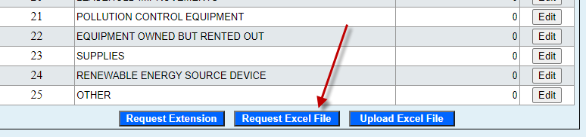
EXCEL UPLOAD (if needed)
On the Asset Summary section, you can request an excel file and/or upload an excel file.
A new business cannot request an excel file since they do not have a prior year’s filing.
However, if you would like to use our formatted office spreadsheet, select request an excel file and you will be sent an email with a blank spreadsheet.
If you are reporting leased assets, you must put the correct address/location for each asset listed.

Slide 30
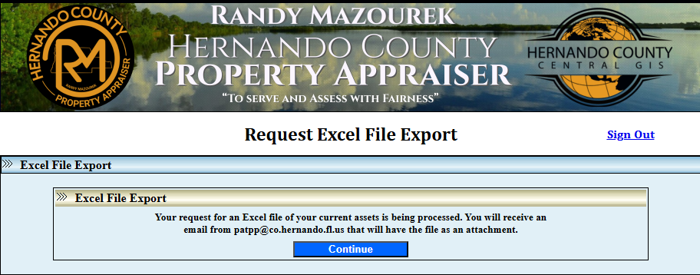
The Excel file will be emailed to you as an attachment.
If no online edits have been made, you will receive last year’s asset list.

Slide 31
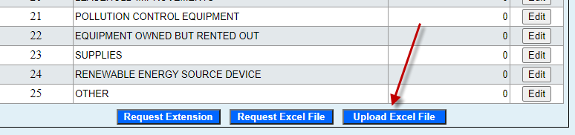
Once you receive the excel file, save it to your personal computer.
DO NOT change the formatting.
Once you have made changes and saved the file select “Upload Excel File”

Slide 32
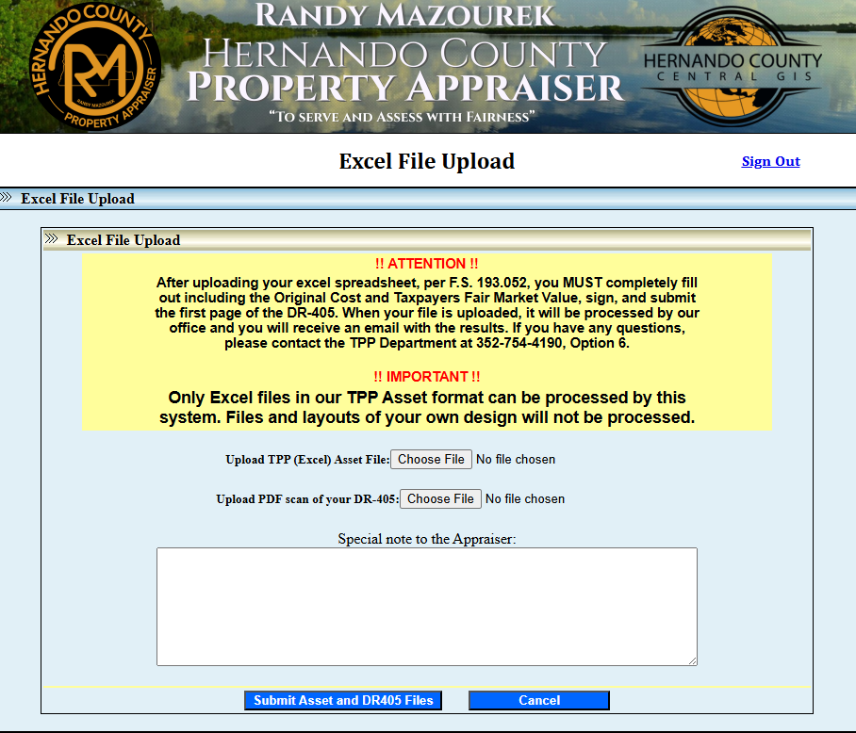
Per F.S. 193.052, you must completely fill out and sign the first page of the DR-405.

Slide 33
To upload the TPP Excel asset file, select Choose File. Find the file on your local computer and select open to upload the file.

Slide 34
To upload the DR-405 PDF, select Choose File. Find the file on your local computer and select open to upload the file.

Slide 35
Once both file types are uploaded, add any special notes to the appraiser. Then, select “Submit Asset and DR405 Files.” Once you have submitted the files, no changes can be made to the online account for this tax year.

Slide 36
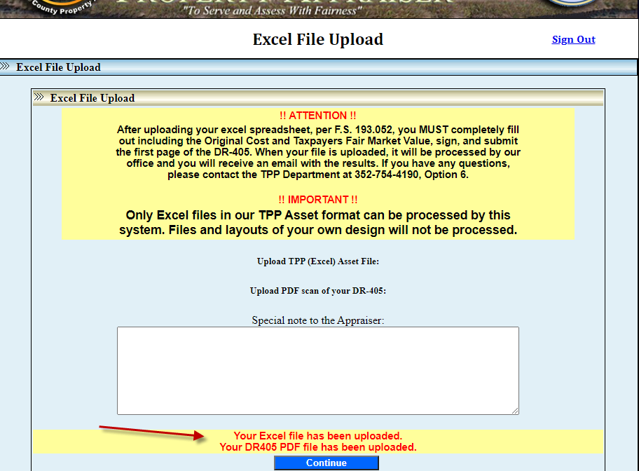
After your files are uploaded, they will be processed by our office and you will receive an email from our office confirming acceptance or rejection of your filing. Please keep in mind that during high volume filing times, it may take up to 72 hours to receive an acceptance or rejection for your filing.

Slide 37
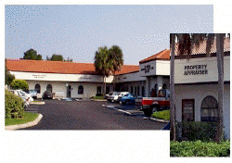

Office Locations:
Brooksville Office
201 Howell Avenue, Ste. 300
Brooksville, FL 34601-2042
(352) 754-4190 Phone
Tangible Personal Property
201 Howell Avenue, Ste. 300
Brooksville, FL 34601-2042
(352) 754-4190 Phone
Westside Office
7525 Forest Oaks Boulevard
Spring Hill, FL 34606-2400
(352) 754-4190 Phone
Addressing
7525 Forest Oaks Boulevard
Spring Hill, FL 34606-2400
(352) 754-4190 Phone

Slide 38

If you have any questions,
please call the Tangible Personal
Property Department at
(352) 754-4190, Press 2, Then 3
Or email patpp@hernandocounty.us
Revised 12/30/2025

